Slide 1
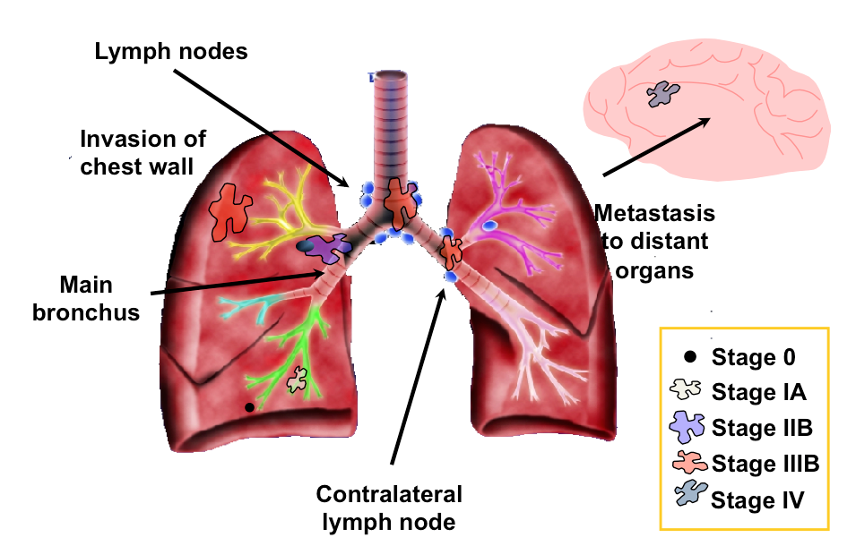
Lung Cancer
Types of Lung Cancer: Small Vs Non-Small
Small Cell Lung Cancer
Non-Small Cell Lung Cancer
- Adenocarcinoma
- Large Cell
- Squamous cell

Slide 2
Lung Cancer Stages | Description
Stage 0 | Tumor is confined to airway lining
Stage IA | Tumor spread to nearby lung tissue
Stage IIB | Tumor reached bronchus
Stage IIIA | Operable Tumor invaded chest wall, trachea and lymph
Stage IIIB | Inoperable Tumor invaded chest wall, trachea and lymph
Stage IV | Metastasis to brain

Slide 3
Lung Cancer Treatment
Stage IA
Stage IIB
Stage IIIA
Stage IIIB (can’t do surgery)
Stage IV
Initial Treatment:
Surgery
+
Cisplatin (4 cycles)
+
Vinorelbine (4 cycles)
Initial Treatment:
Surgery
+
Cisplatin (4 cycles)
+
Vinorelbine (4 cycles)
+
Radiotherapy
Initial Treatment:
Cisplatin (4 cycles)
+
Vinorelbine (4 cycles)
+
Radiotherapy
Surgery
When Initial Tx fails
If
Adenocarcinoma
If
Large Cell
if
Squamous
If initial Tx fails:
Cisplatin (4 cycles)
+
Vinorelbine or Paclitaxel
(4 cycles)
Check EGFR
Doublet Chemo
(Next slide)
Doublet Chemo
+
Bevacizumab
If EGFR positive:
Erlotinib
If EGFR negative:
Cisplatin
+
Pemetrexed
Notes:
http://jnci.oxfordjournals.org/content/99/11/828.full

Slide 4
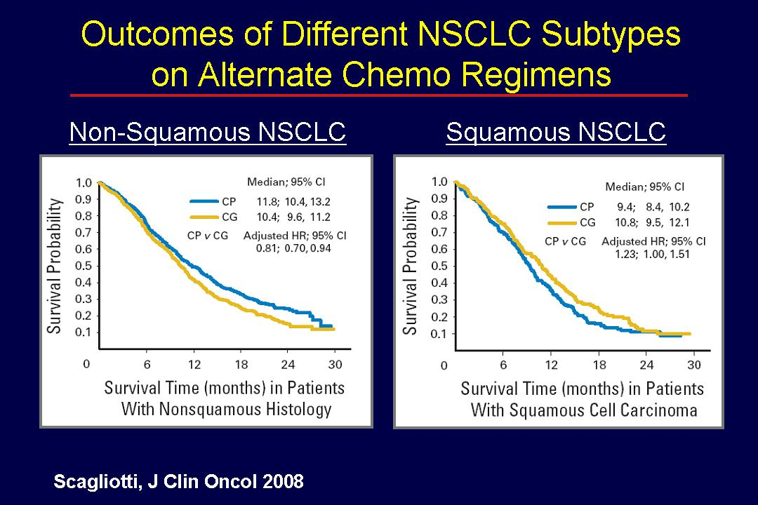
Doublet Chemo (previous slide)
Carboplatin or Cisplatin
+
paclitaxel or docetaxel
or gemcitabine or vinorelbine, irinotecan or etoposide or pemetrexed for 4-6 cycles
Gemcitabine vs Pemetrexed:
Cisplatin + Pemetrexed is better for Non-Squamous Lung Cancer (that’s why it’s used for adenocarcinoma)
Cisplatin + Gemcitabine is better for Squamous Lung Cancer (that’s why doublet chemo has gemcitabine)
Notes:
Doublet Chemo:
Cisplatin or Carboplatin in combination with a taxane, gemcitabine, vinorelbine, irinotecan, etoposide or pemetrexed for 4-6 cycles (stage IIIB or IV)

Slide 5
Side Effects
AGENT | Common Side Effects | Other Concerns
Cisplatin | Nephrotoxicity, N/V, neuropathies | Needs IV hydration and electrolyte monitoring
Carboplatin | BMS, N/V, neuropathies | Dose using Calvert Equation based on CrCL
Pemetrexed | BMS, diarrhea, alopecia | Requires supplementation with folate, B-12
Paclitaxel | BMS, neuropathies, alopecia | Hypersensitivity reactions – require premeds
Gemcitabine | BMS, flu-like symptoms | Cannot be combined with chest irradiation
Bevacizumab | HTN, bleeding, rash | Treat HTN
Erlotinib | Acneiform rash | May require tetracycline, drug interactions
Vinorelbine | Neurotoxicity, BMS | Neuropathy can be severe
Etoposide | BMS | IV only

Slide 6
Lung Cancer | Initial Treatment | If initial doesn't work, then: Adjuvant Chemo
Stage 0
Stage IA | Surgery
Stage IIB | Surgery + Cisplatin + Vinorelbine (4 cycles) | Cisplatin (4 cycles) + Vinorelbine or Paclitaxel (4 cycles)
Stage IIIA | Surgery + Cisplatin + Vinorelbine (4 cycles) + Radiotherapy | Cisplatin (4 cycles) + Vinorelbine or Paclitaxel (4 cycles)
Stage IIIB | NO Surgery Cisplatin + Vinorelbine (4 cycles) + Radiotherapy | Carboplatin + paclitaxel or docetaxel
Stage IV | Game Over
Ignore this
Notes:
Oncologists in the United States have embraced carboplatin as their favorite platinum drug for the first-line treatment of patients with metastatic non–small-cell lung cancer (NSCLC).
Carboplatin has similar efficacy but lower rates of nausea, leukopenia, and nephrotoxicity than cisplatin.

